Slide 1

AutoCAD Eagle Schematic + PCB Design Workshop
Presented By:
David Story
Advised:
Dr. Farid Farahmand

Slide 2
Introduction
This lab will get you familiar with board design tools in AutoCAD Eagle
You should have AutoCAD Eagle Community or Student downloaded
Your goal is to create a schematic and printed circuit board for a bandpass filter
You will be provided with tutorials and information on schematic creation, board creation, and related software tools.

Slide 3
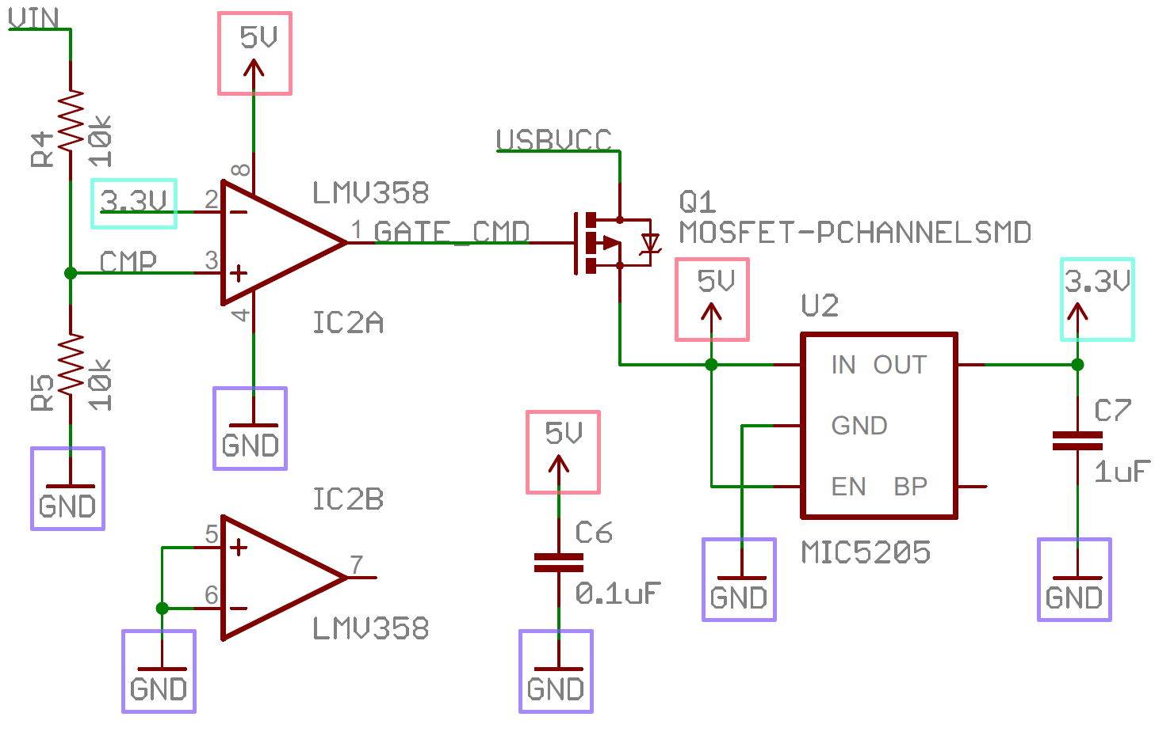
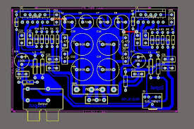
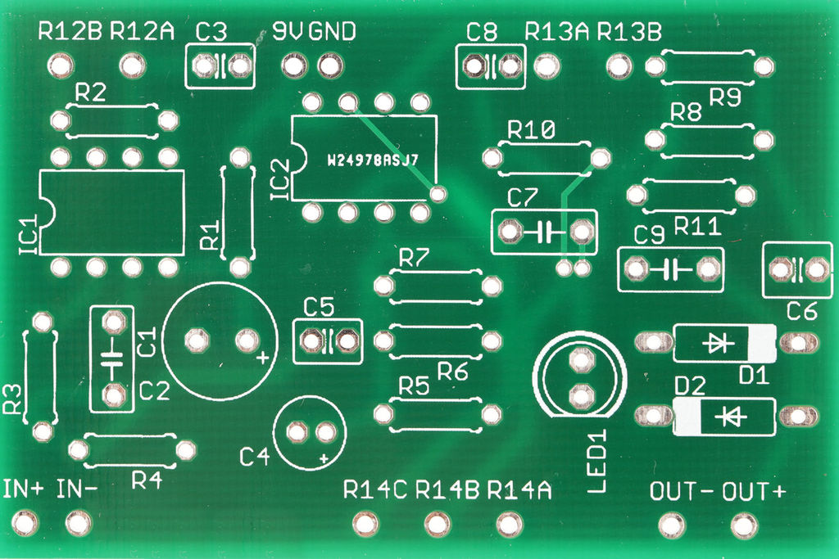
What you can look forward to learning
Schematic Design
Creating Schematic File
Adding and Selecting appropriate parts
Manipulating and naming parts
Wiring and debugging schematic
Board Design
Dimension and grid setting
Part manipulation and labelling
Board routing
Multilayer design
Wiring and via connections
Plane creation
Board Production
Generating gerber files
Viewing and checking gerber files
Selecting a proper manufacturer
Viewing manufacturer design rules
Setting board preferences
Viewing manufacturer renderings
Purchasing board

Slide 4
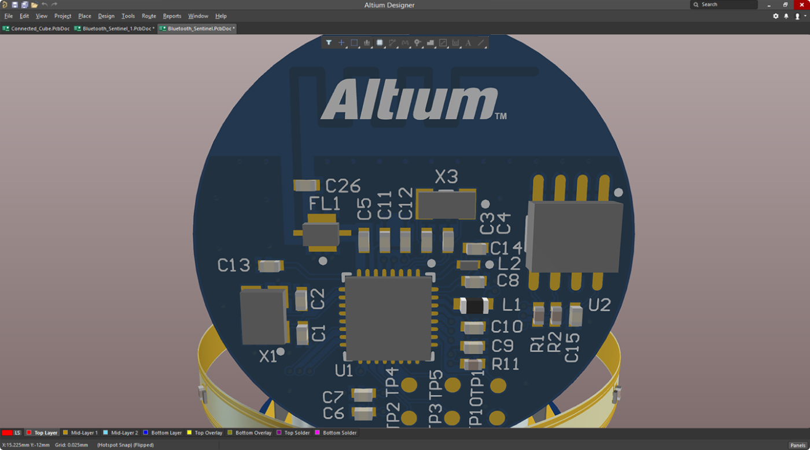
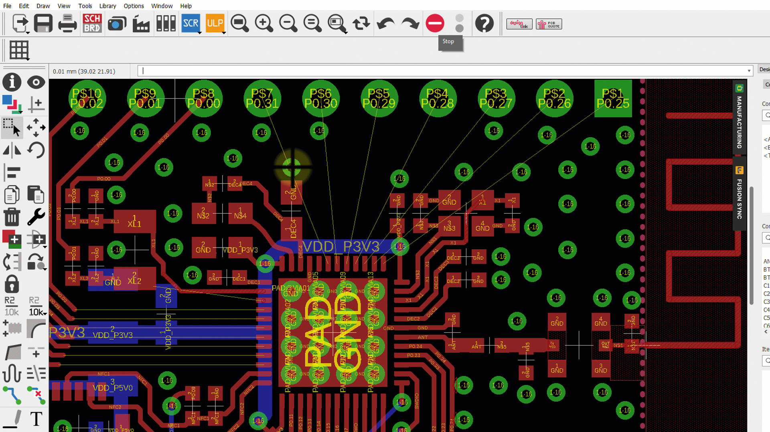
Schematic & Board Software
For this workshop we will be using AutoCAD Eagle, this is software designed by AutoDesk that allows you to create schematics and PCB board files.
There are other software such as Altium Circuit Studio, Altium Designer, KiCad, EasyEDA, etc.
The reasoning for using Eagle for this workshop is that is has an intuitive UI while still retaining a lot of tools that are found in other professional software.
Eagle is found in industry, it is not as common as Altium Designer which as more professional tooling; however, Eagle has a free community version. Look to spend around $7500+ plus a subscription for Altium Designer.

Slide 5
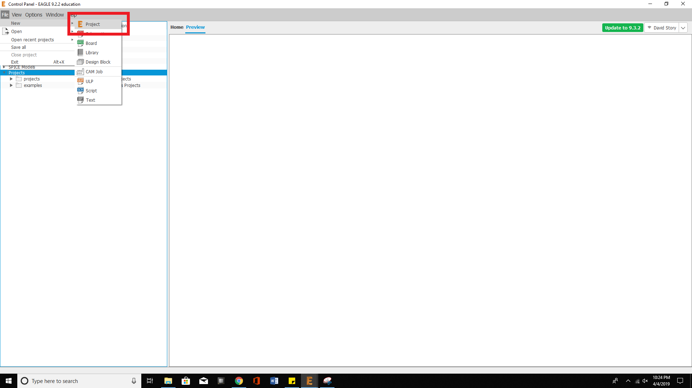
Creating a New Eagle Project

Slide 6
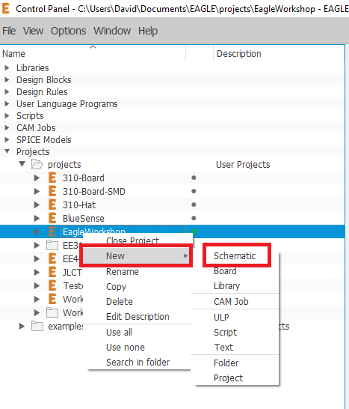
Creating Schematic File
Right clicking on the newly created Eagle Project will bring up several options, select the one that says “New”
From here click the Schematic button, this will generate a new schematic file in your newly created project
After creating, you can change the name of the schematic by using opening the schematic and going to the “File\Save as” tab.
Open the schematic file to being learning about the schematic editor

Slide 7
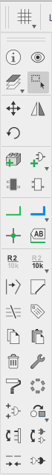
Schematic Tool Bar
1. Information – with this tool you can press on a symbol and get information.
2. Move – this tool allows you to move symbols / groups
3. Rotate – allows you to rotate symbols / groups
4. Wire – allows you to connect parts, symbols, pins
5. Junction – creates wire and part junctions
6. Name – names wire ‘nets’, wires that share name will be connected
7. Copy – copy a part or symbol by pressing on it
8. Delete – deletes wires, symbols, parts, etc
9. View – highlights part and all wires connected if pressed. Highlights will also appear on .brd parts.
10. Select – allows you to select groups of parts, wires, symbols.
11. Mirror – mirrors a part or symbol
12. Add Part – accesses Eagle part library to select parts for schematic
13. Net Label – creates a label for a wire that designates its name
14. Value – used to assign a value to a part (e.g. set resistor value)
15. Paste – pastes any copied items
16. Properties – brings up menu of different part properties you can edit
1.
9.
10.
2.
11.
3.
12.
4.
5.
13.
6.
14.
7.
15.
8.
16.

Slide 8
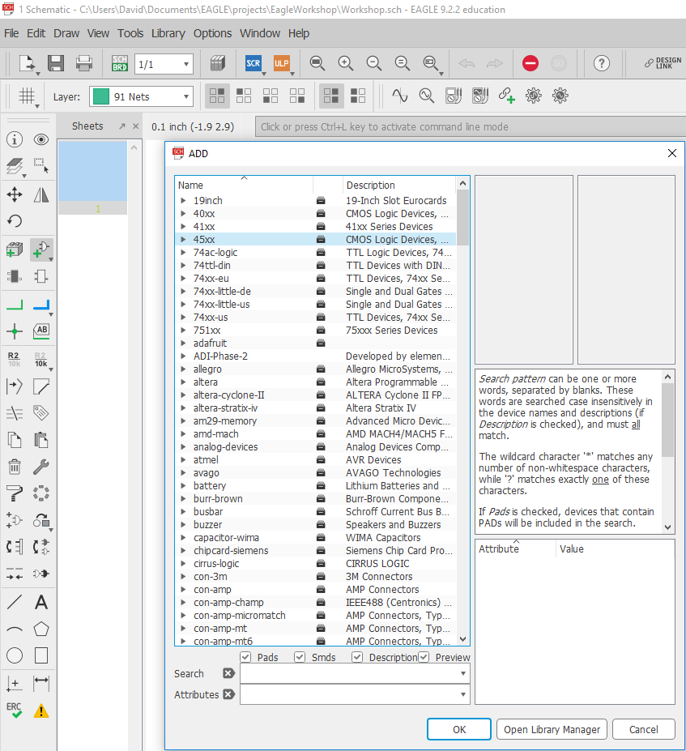
Adding Parts
Click on the Part button to open the menu
The parts here are parts that are created by Eagle or by third parties (some manufacturers, distributors, users, etc)
If there is a manufacturer name, be warned, a lot of the parts they make might not be included (e.g. microchip might make a new PIC that they will not include a Eagle part for). You might need to make the part yourself.
In this list, scroll or search for the library “rcl”. This is the resistor-capacitor-inductor library

Slide 9
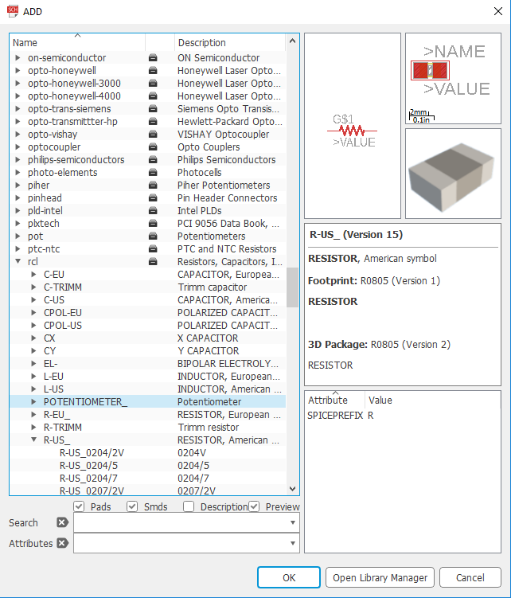
Adding Parts - Continued
Once you find the “rcl” library, open the library and open the “R-US” tab. This is the US resistor library that has resistor sizes in metric.
You will notice there are other tabs such as C-EU, C-TRIMM, etc. Explore these tabs and see what types of components are in them. Note their sizing and footprint. Some will be SMD and some will be through hole.
It is absolutely crucial to understand what sizing, tolerances, power ratings you need for your circuits when selecting components at this stage.
It is also recommended to check electronics distributors first to make sure that part is available. Design based on parts you know you can buy, do not design the schematic and then search for that part, because it might not be available.

Slide 10
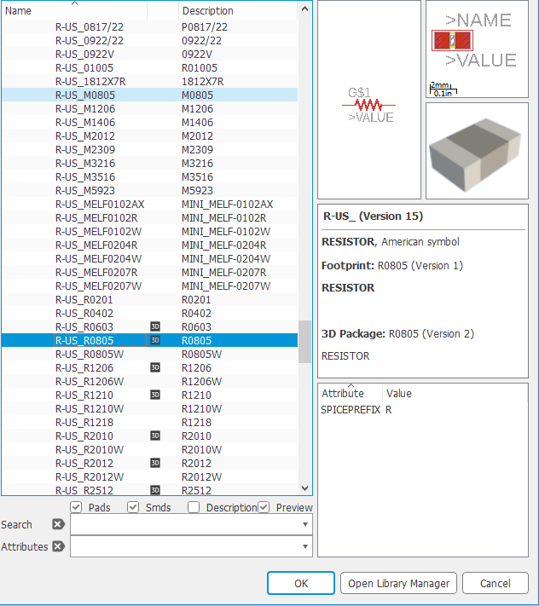
Selecting Part Sizes
For SMD in US, there are different sizes such as 1206, 0805, 0402, 0201, etc. Note how small some of these parts are. Since we are learning, we will select a moderately small but still simple enough to solder component.
Typically larger components (SMD 1206, 1210) can have higher power tolerances. (e.g some 1206 resistors are rated up to 1 watt, where as 0805 might be rated up to a quarter watt)
Note special designations on parts, a 1206 and 1206W resistor might have the same length, but the 1206 will have a larger width.
You can sometimes get away with having a bigger pad for a part, but you most likely won’t be able to put a larger part on a smaller pad.

Slide 11
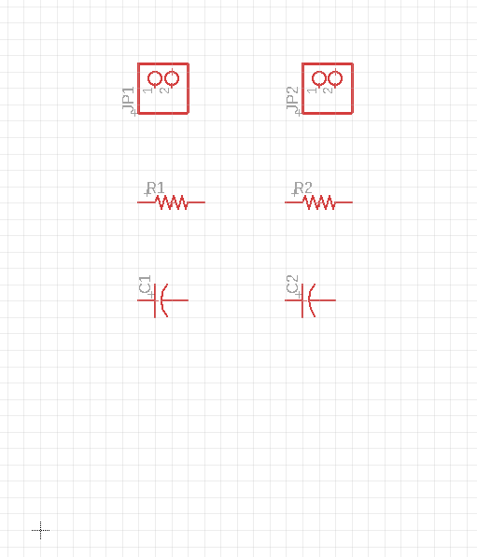
Finish Adding Parts
We are creating a simple bandpass filter, for this we will need some pin headers for our input and output, and we will need two capacitors and two resistors.
You can find the pinholes in the Eagle library “pinhead”
Select a resistor and capacitor size that you feel comfortable soldering and that is commercially available. When in doubt, check what parts you currently have or mouser, digikey, arrow, etc.
My recommendation for new SMD learners would be 1206 or 0805.
Add the parts you selected to the schematic and then proceed to the next slide to learn how to orientate and wire the parts

Slide 12
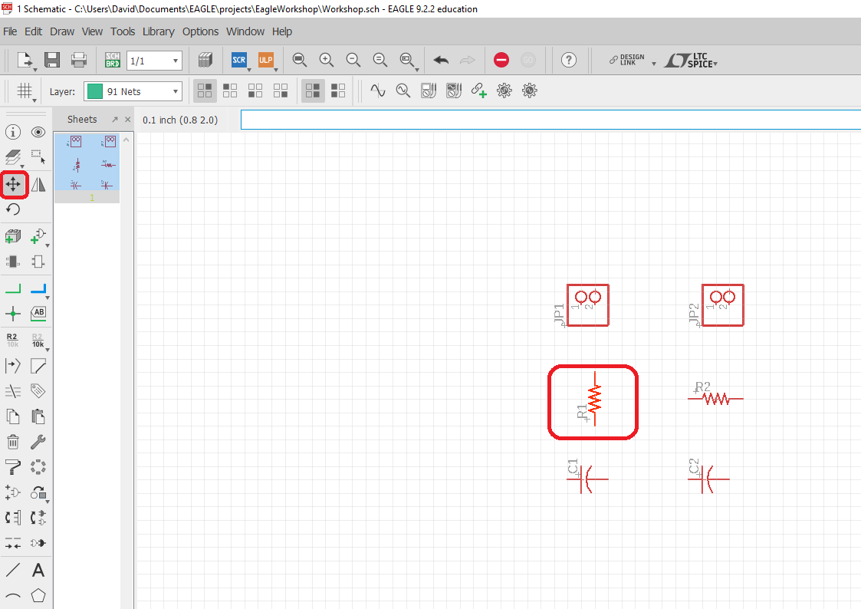
Moving and Rotating
After selecting the move tool, press the parts that you would like to use
While moving the part, right clicking will rotate the part
Ensure that parts are well spaced and are not overlapping.

Slide 13
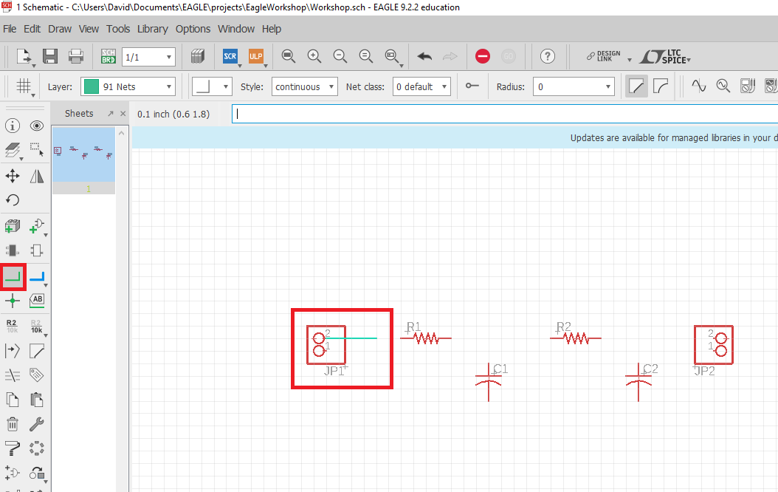
Wiring the Schematic
Select the wire tool to begin wiring the schematic
A green circuit should appear over the part pin that you want to wire. Select the pin to connect to the part
Once you have pressed, you can then ‘trace’ the wire to the pin of the part you want to connect to
You can also move wires after you have traced them with the move tool.

Slide 14
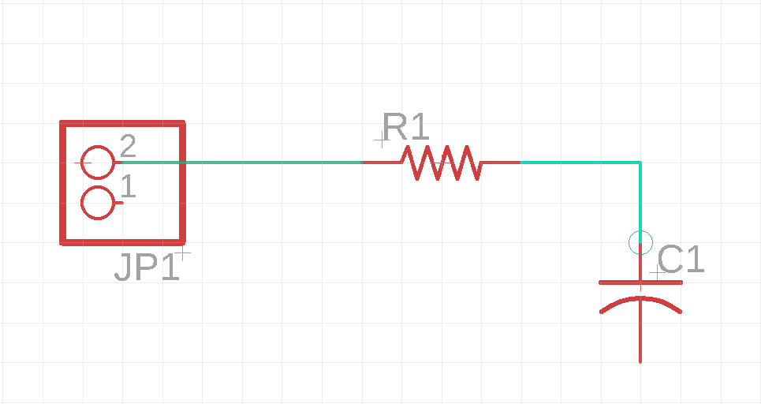
Examples of Wiring
Note that when you are hovering over the pin and the green circle is in view, the part is still not connected
Press the pin when the green circle has appeared to ensure a good connection.
Use the move tool to move the wire around, if the wire does not appear to be connected to the part pin, then you do not have a good connection. Delete the wire and try again if this happens

Slide 15
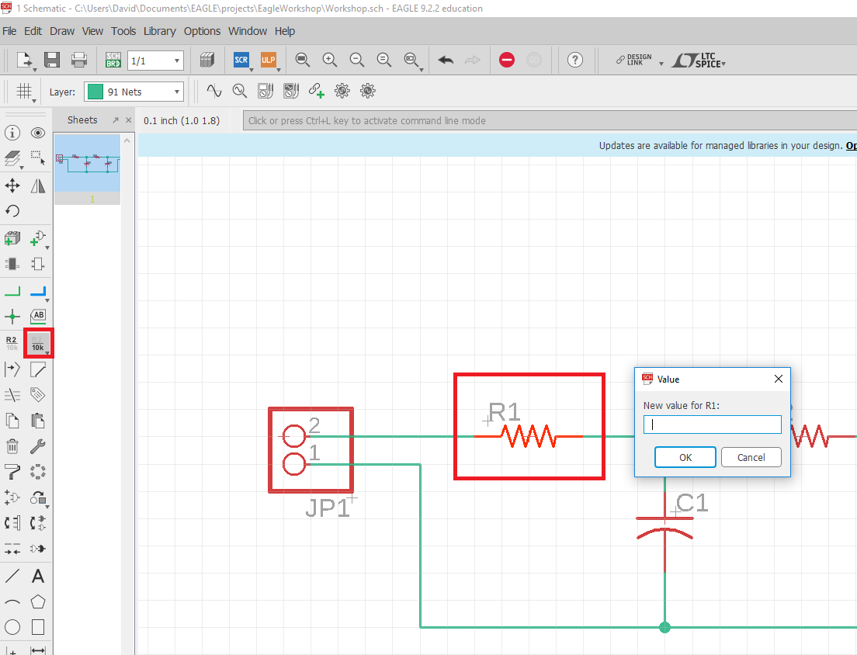
Adding Values
Adding values to a part allows you to label parts that may have values (e.g. you can label passive part values or you can add values of IC that designate some parameter)
Using the value tool, click on the part you would like to add a value to
A box should appear, type the value in.
The value will now appear as text near the part, you can use the move tool to adjust the text location as you see fit

Slide 16
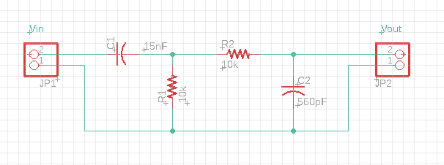
Finished Product
You bandpass filter should appear as follows. You can use this tutorial to learn more about passive band passes and what ranges you want: https://www.electronics-tutorials.ws/filter/filter_4.html
Text can be added with toolbar symbol that appears as an “A”
Note that for JP1 and JP2, Pin 2 is the positive Vin, and Pin 1 is the negative or “ground” pin
Ensure that all wires are connected to parts by selecting the move tool and moving the wires near the part connection, if the wire is really connected to the part the wire should always terminate at the part port.

Slide 17
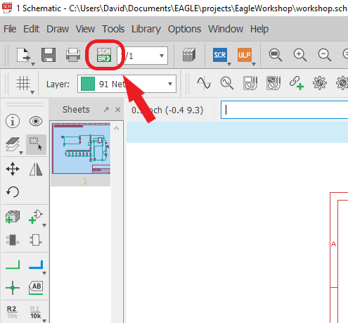
Creating a board file from the schematic
Press the schematic file to open it
Observe the schematic and analyze how it works
When you are ready, press the “sch/brd” button and press “yes” on the pop-up to create a new board.
This board file will be linked to your schematic file. All the parts and connections in your schematic will be mirrored in the board file

Slide 18
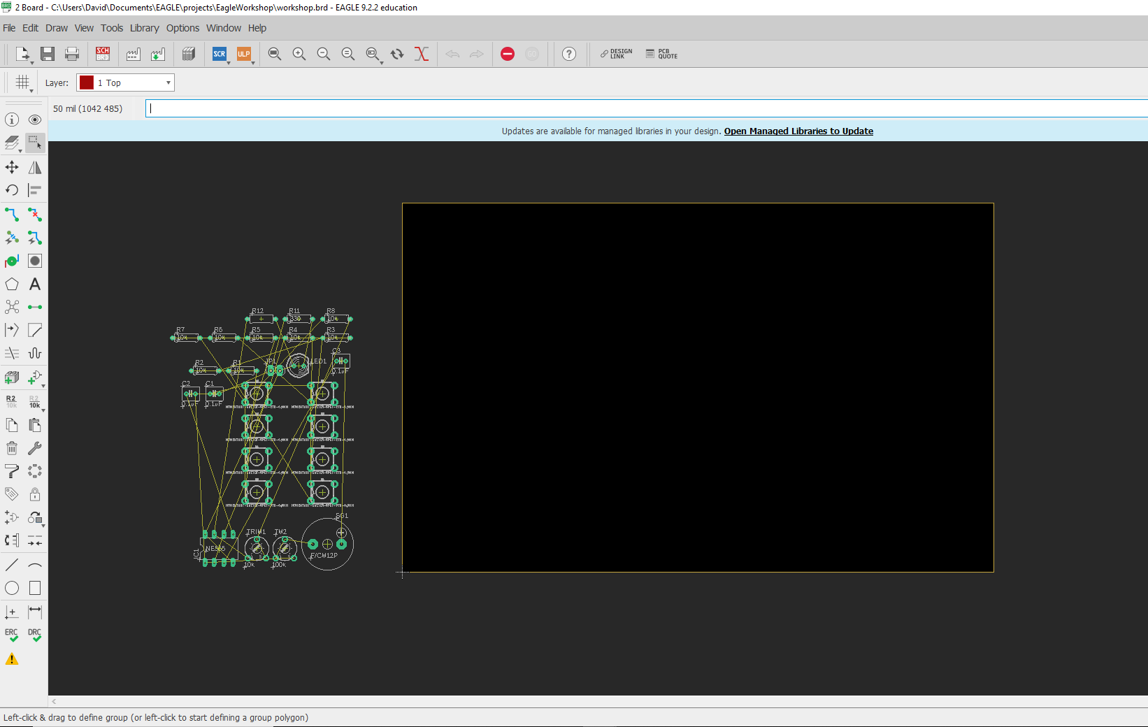
Board File
Your new board file will look like this
The parts are show on the left. The solid black box on the left is the PCB. The yellow outline of the black box defines its dimension
We will now learn about this page, some tools on the sidebar, and then learn how to change the boards dimensions.

Slide 19
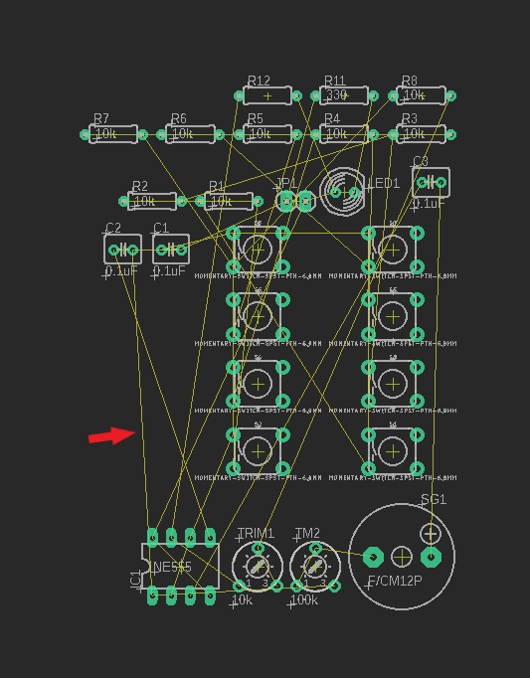
The Rat’s Nest
The yellow lines, like the one the arrow is pointing to, is called a “rat’s nest”
The rat’s nest shows where the trace (the copper lines) have to go to properly connect the pads or pins of your parts.
When you wire together parts in the schematic, the rat’s nest reflects these changes.
The rat’s nest is not a valid connection yet, it is only an outline of where you need to route, in the next few slides we will learn how to physically connect or ‘route’ the parts with copper lines.

Slide 20
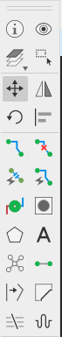
The Toolbar
1.
9.
We will now describe some useful tools on the toolbar. For more in-depth information go to: https://www.autodesk.com/products/eagle/blog/schematic-basics-part-1/
2.
10.
3.
11.
Info – Display part information
Layer settings – shows different copper and silkscreen layers
Move tool – use to move parts, traces, dimensions, etc
Rotate – use to rotate parts, silkscreen, text, etc
Trace – this tool lets you route parts that are connected via rat’s nest
Via – this create a hole with copper connection to switch to different electrical layers
Polygon – lets you create shapes in copper or other defined settings
Rat’s nest – this will re-render the rat’s nest after you move or trace parts
View – this will highlight traces and parts you select
Group – this allows you to select multiple parts, traces, silkscreen, etc.
Mirror – allows you to mirror a part, silkscreen, etc
Rip-up – this button is what you use to delete trace
Text – allows you to add text to board
4.
5.
12.
6.
7.
13.
8.

Slide 21
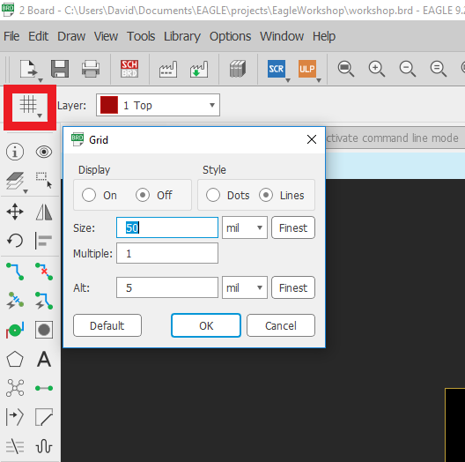
Grid
Grid allows you to set the dimensions type for the grid and for part placement
Can be in inches, mil (1/1000 of an inch) or millimeters.
Display lets you display dots or line that represent your grid size. Good for visualizing sizing of parts and trace lengths.

Slide 22
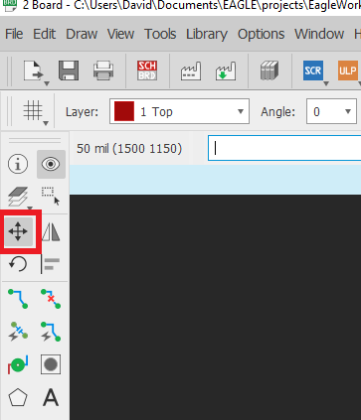
Moving parts
We will now begin by selecting the move tool
We want to use the move tool for two reason right now:
We can use it to manipulate the board dimensions
We can use it to place the parts on the board

Slide 23
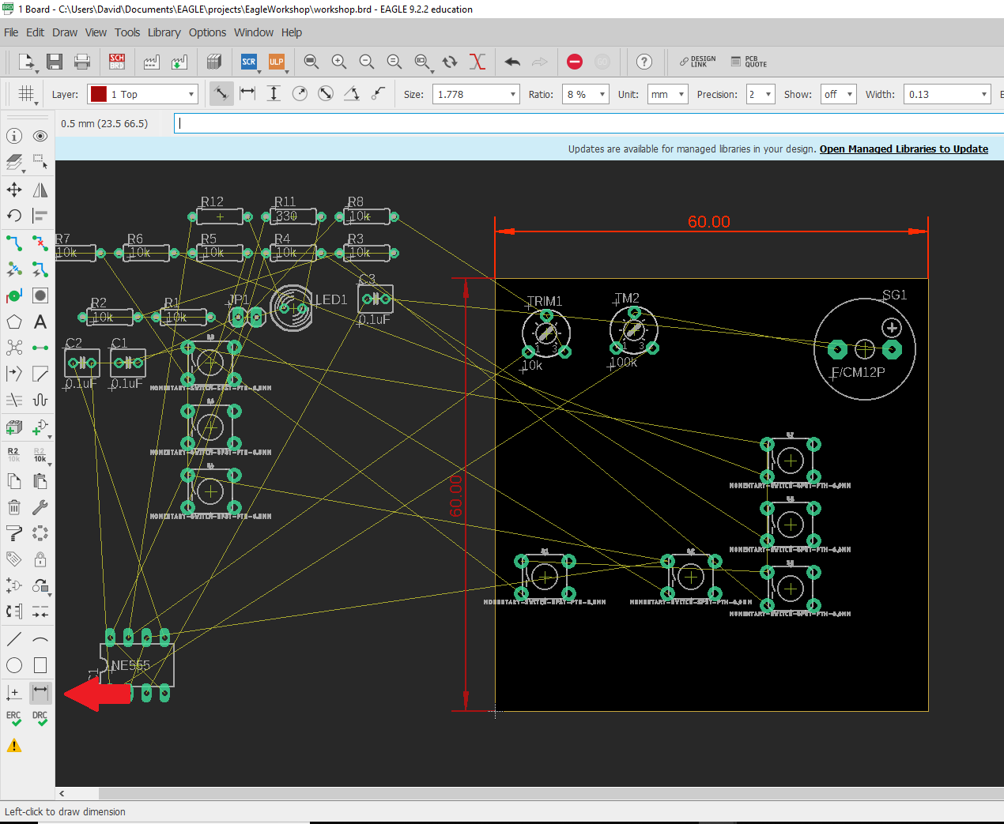
Changing the board dimensions
The arrow points to the dimension tool. Press this button and then press a side on the board to see it’s dimensions
Re-select to the move tool, then grab the edges of the board. Try to make the board around 50 x 50 mm or 60 x 60 mm
Once you have set the board dimensions, try moving parts around.
Select the group tool, press and drag the mouse and try to select some parts. After you selected some parts, select the move tool again. Right click anywhere on the screen. You should see something that says “group”, press that. You can now move groups of parts.

Slide 24
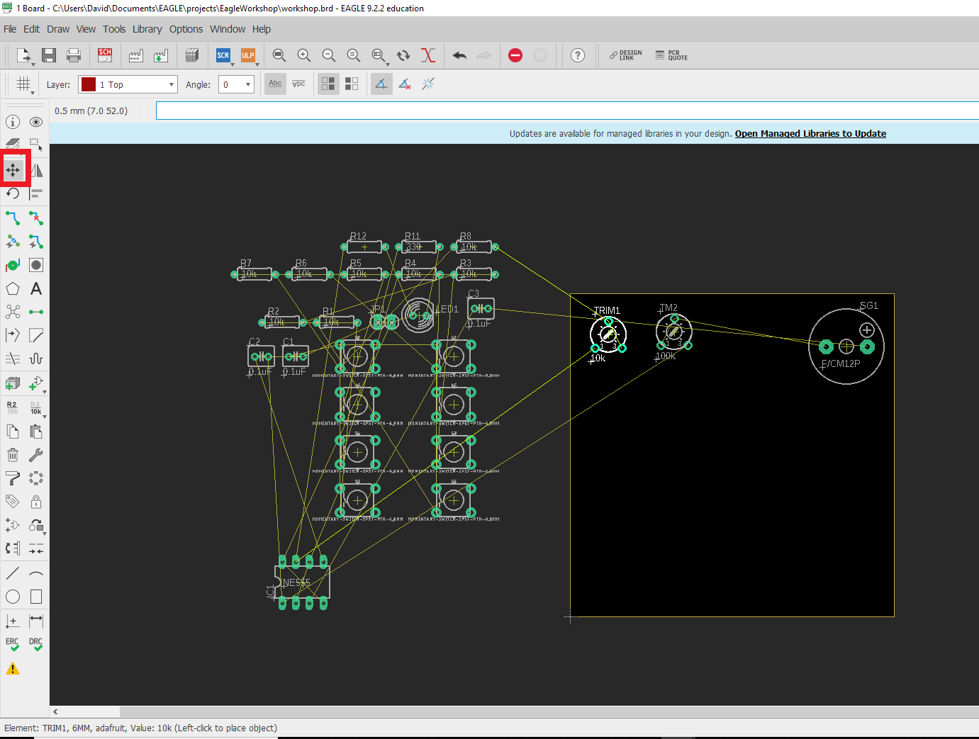
Moving parts onto the board
Now that the dimensions are set and you know how to move parts, move all the parts onto the board area.
Position the parts so that they do not overlap. Think about how you will solder these parts, make sure to leave room so you can easily solder parts.
Make sure pads are fully on the board
Parts that are connected together should be positioned so their pads are close, this will make routing the copper easier.

Slide 25
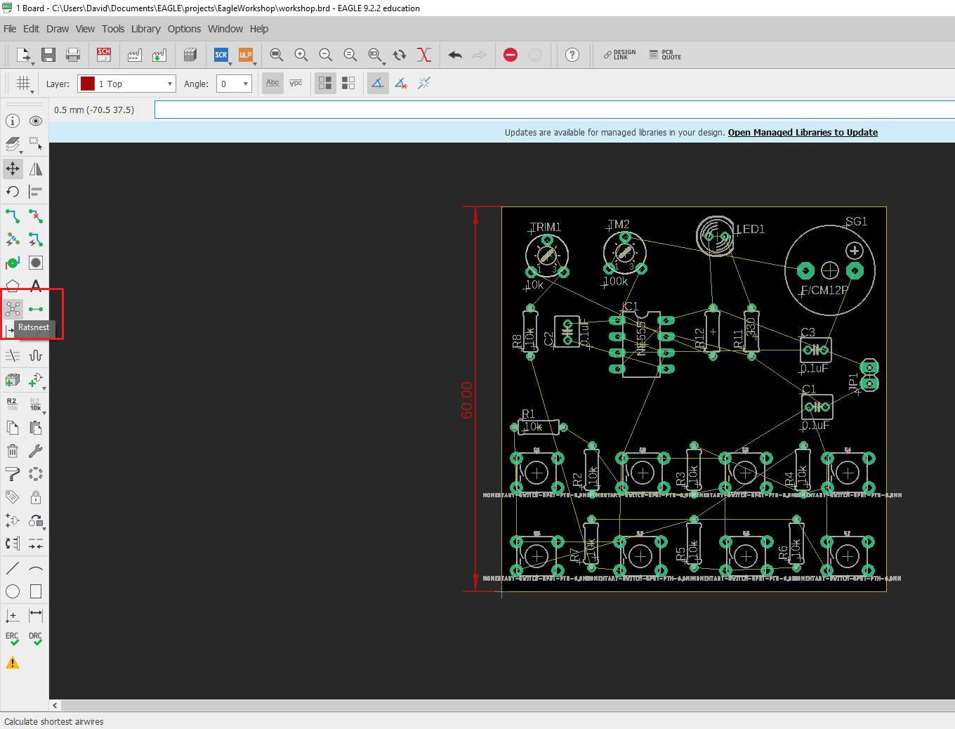
Preparing to route
Once you have placed the parts on the board, press the “Ratsnest” button to re-render the rat’s nest connections
Take another moment to look over the board for any missed connections, any overlapping pads.
White text, also called silkscreen, can overlap, as it is not an electrical connection.
Take a quick break to prepare yourself to route your first printed circuit board.

Slide 26
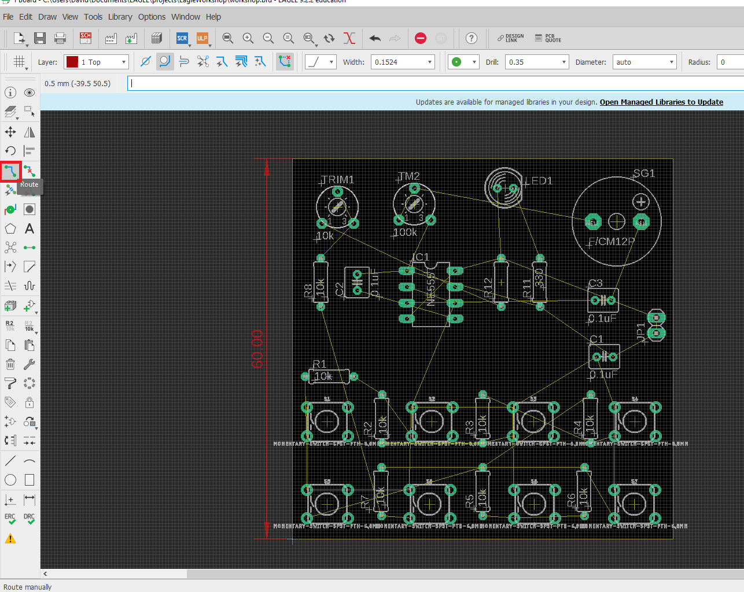
Routing the board
Press the ‘route’ button to select the routing tool
You can now press any pad / pin / rat’s nest and begin routing the lines.
This is a two layer board so you can route trace on the Top and Bottom of the board.
We will cover how to switch connections between layers in the next slides. Practice routing on the top layer for now.

Slide 27
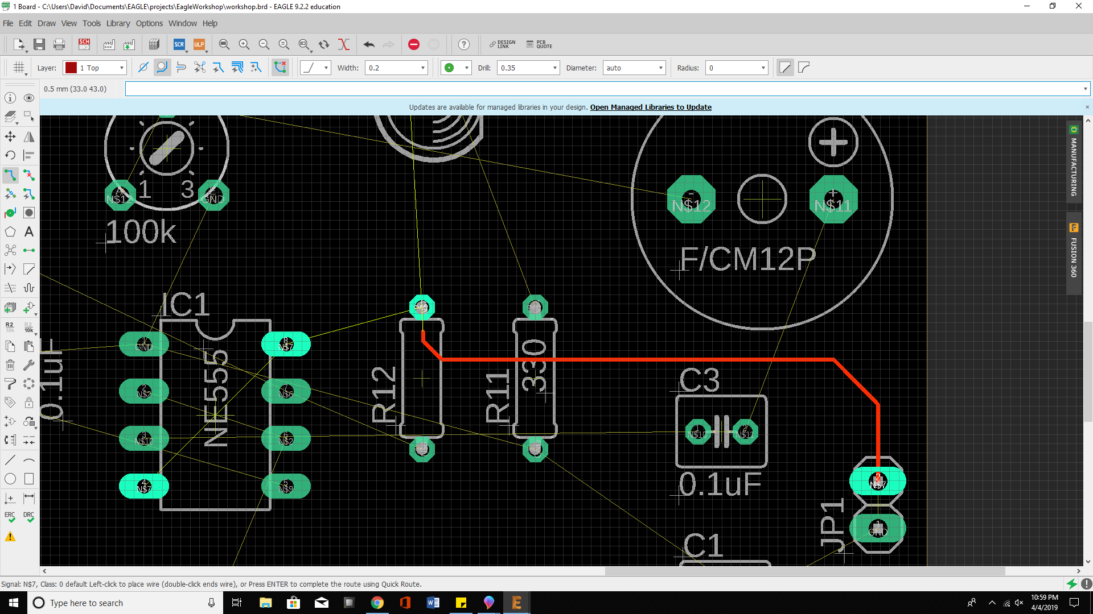
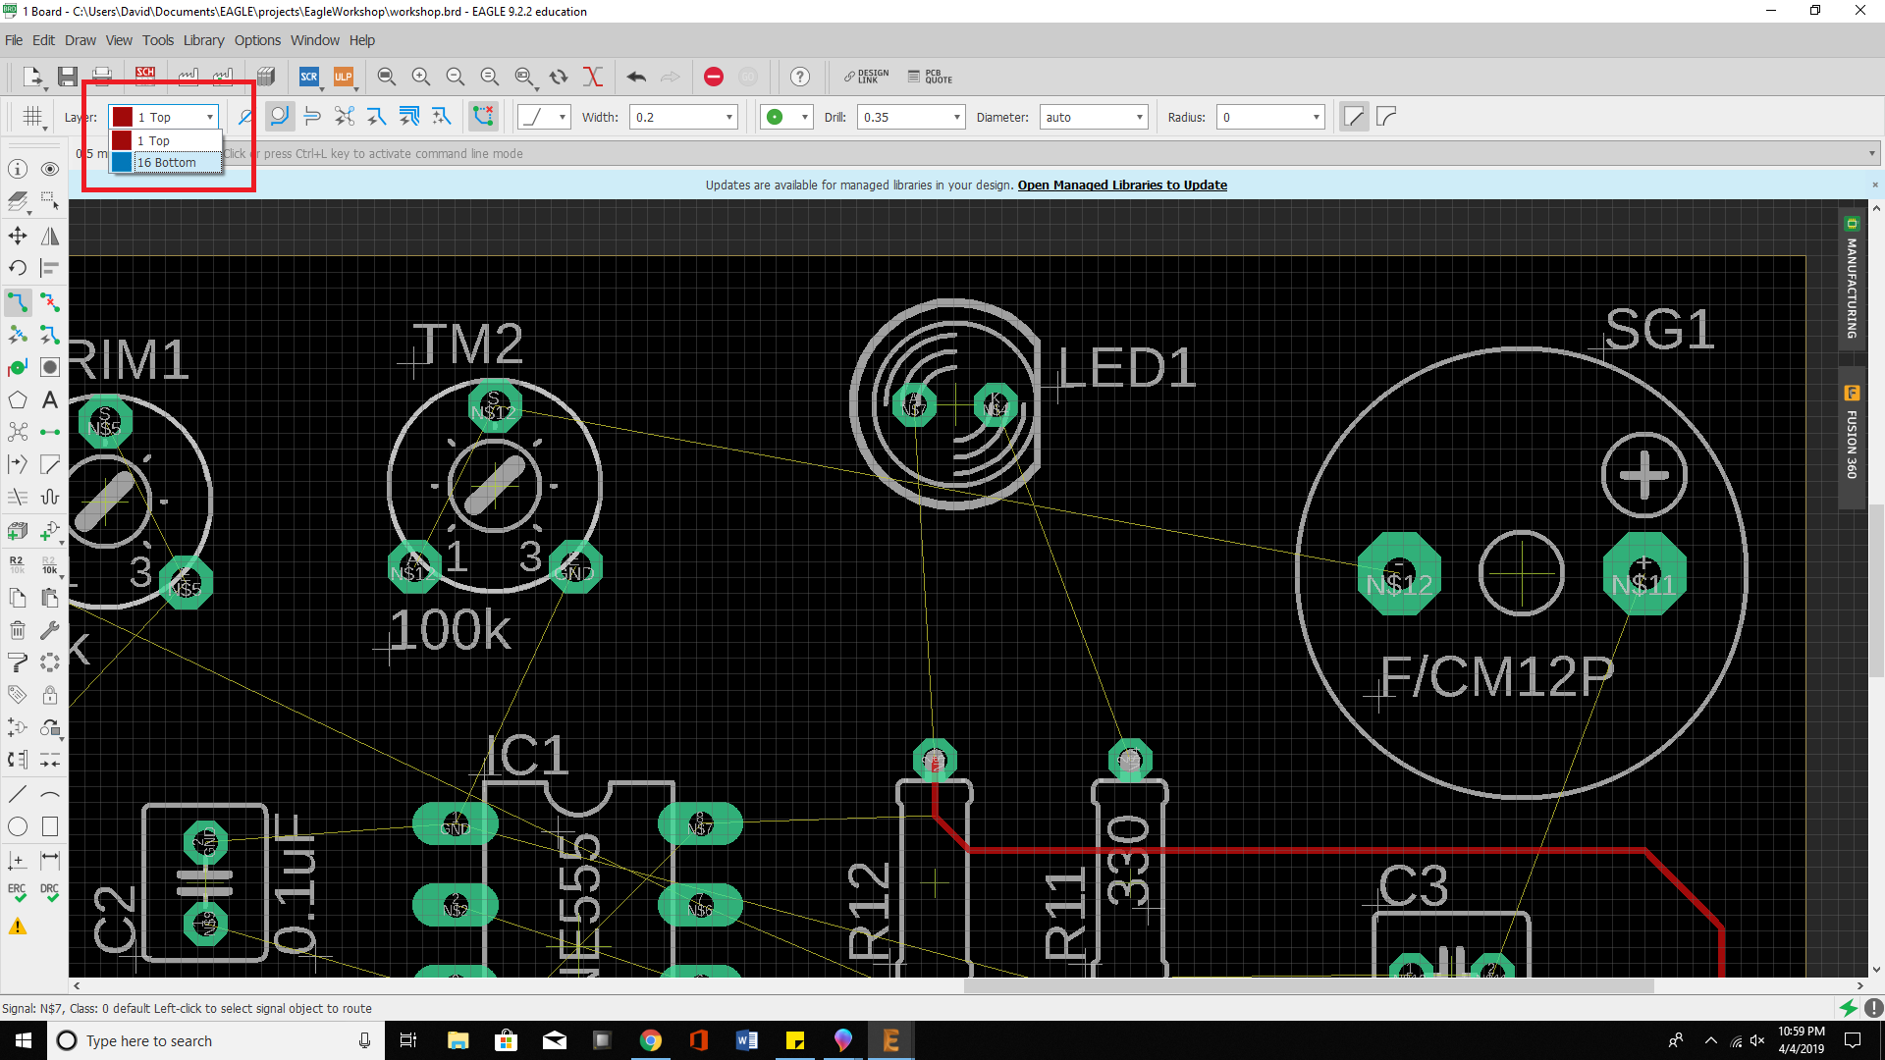
Routing the board
When routing, ensure that you actually connect to the pad or pin you are trying to route to.
Once you successfully route to the pad or pin, the trace will not be ‘bright’, meaning it is connected.
You can test the connection by using the move tool to move the trace to see if it is unconnected.

Slide 28
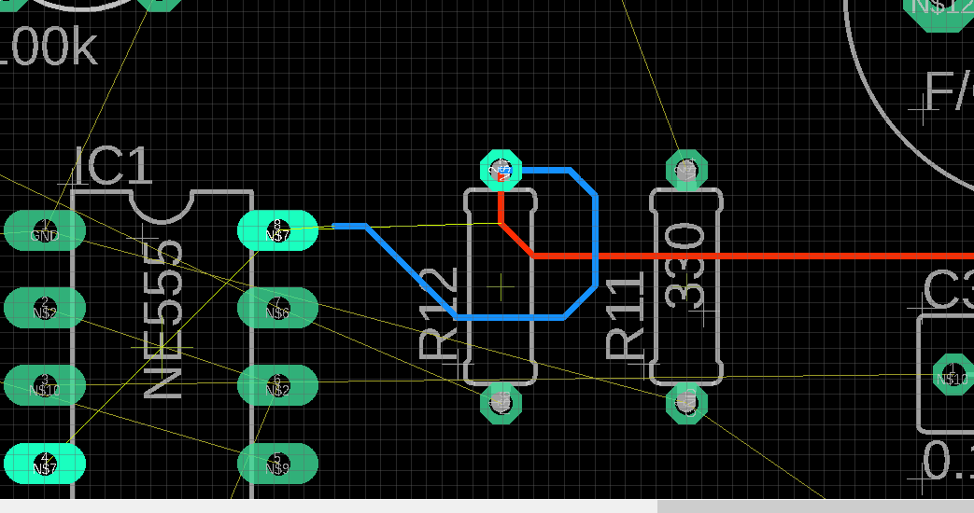
Routing on other layers
Press the drop down menu in the upper left corner, from here select layer 16: Bottom
You are now working on the Bottom layer. Try tracing a pad, you will probably see a blue line. This means the trace is on the bottom of the board.
Try routing over a red line, since the red line is on the top of the board, its ok to cross over the line since you will not be interfering with it.
In the next slide, we will discuss how you can make top layer lines connect down to the bottom layer.

Slide 29
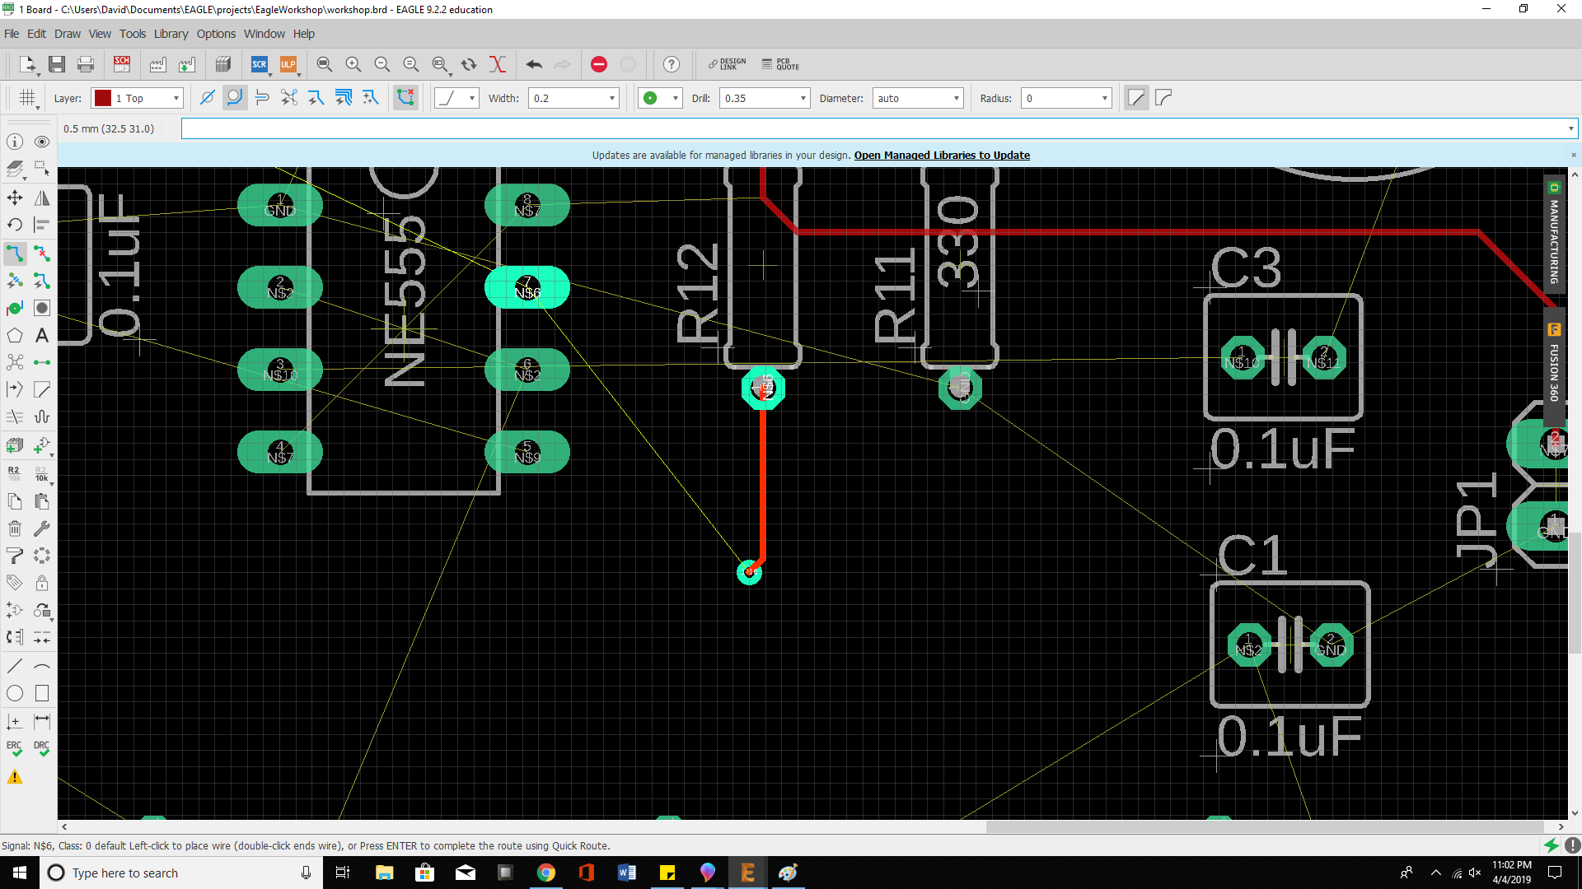
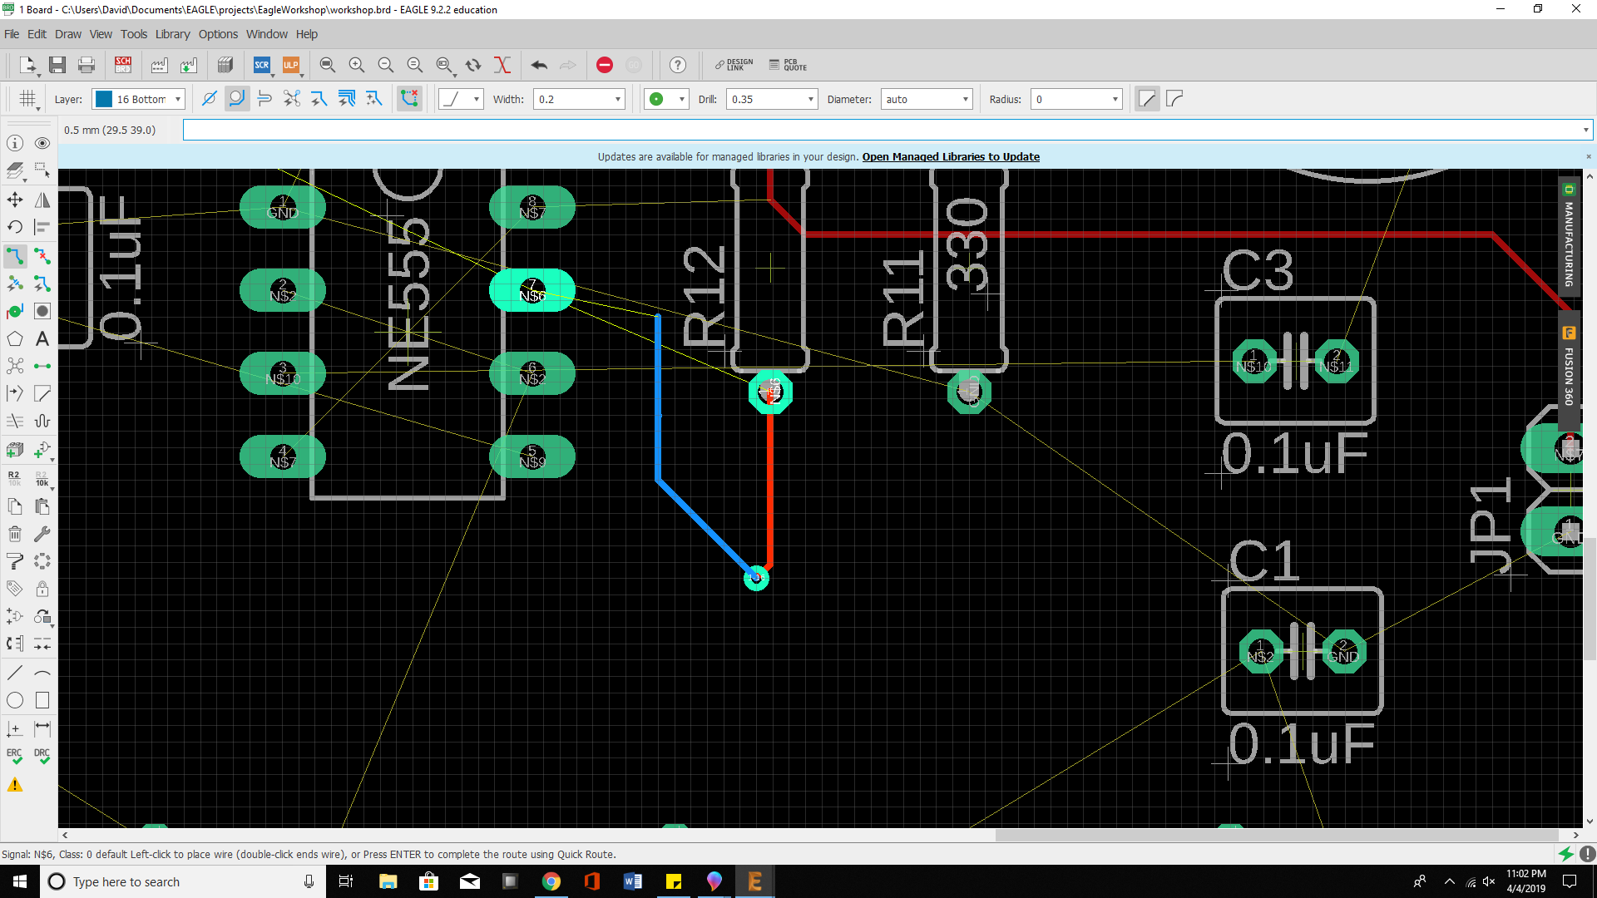
Vias: the portal to the other layers
A via allows you to start tracing on other layers of the board (e.g. you have a top layer trace, and want that same connection to go to bottom layer since a top layer trace is blocking your path)
When routing a line, hit the middle mouse button, a via should appear. Left click to place it. Now you should be routing on the other layer.
Ask the lab assistance for assistance if needed.

Slide 30
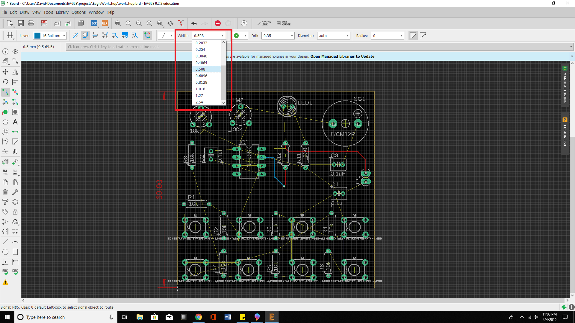
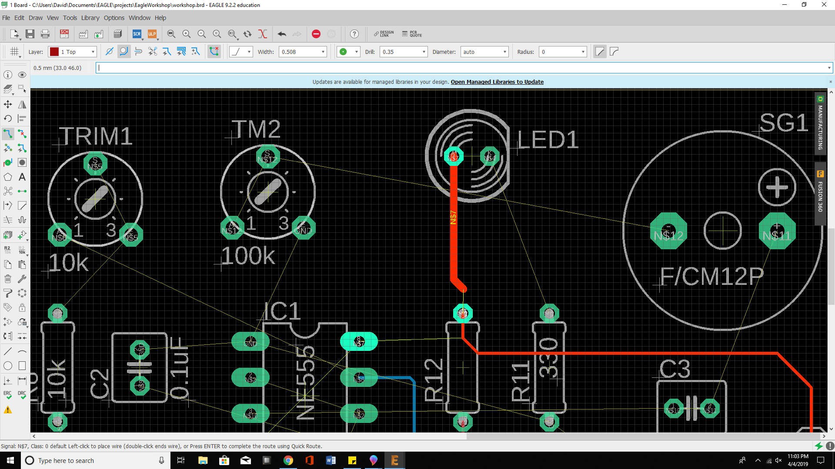
Changing trace width
This is an optional section: you can practice changing the trace width to different sizes.
This allows you to make lines that can carry larger currents or that need to be impedance matched.
For this board, we can use the default trace width, but you can try changing the width for fun.

Slide 31
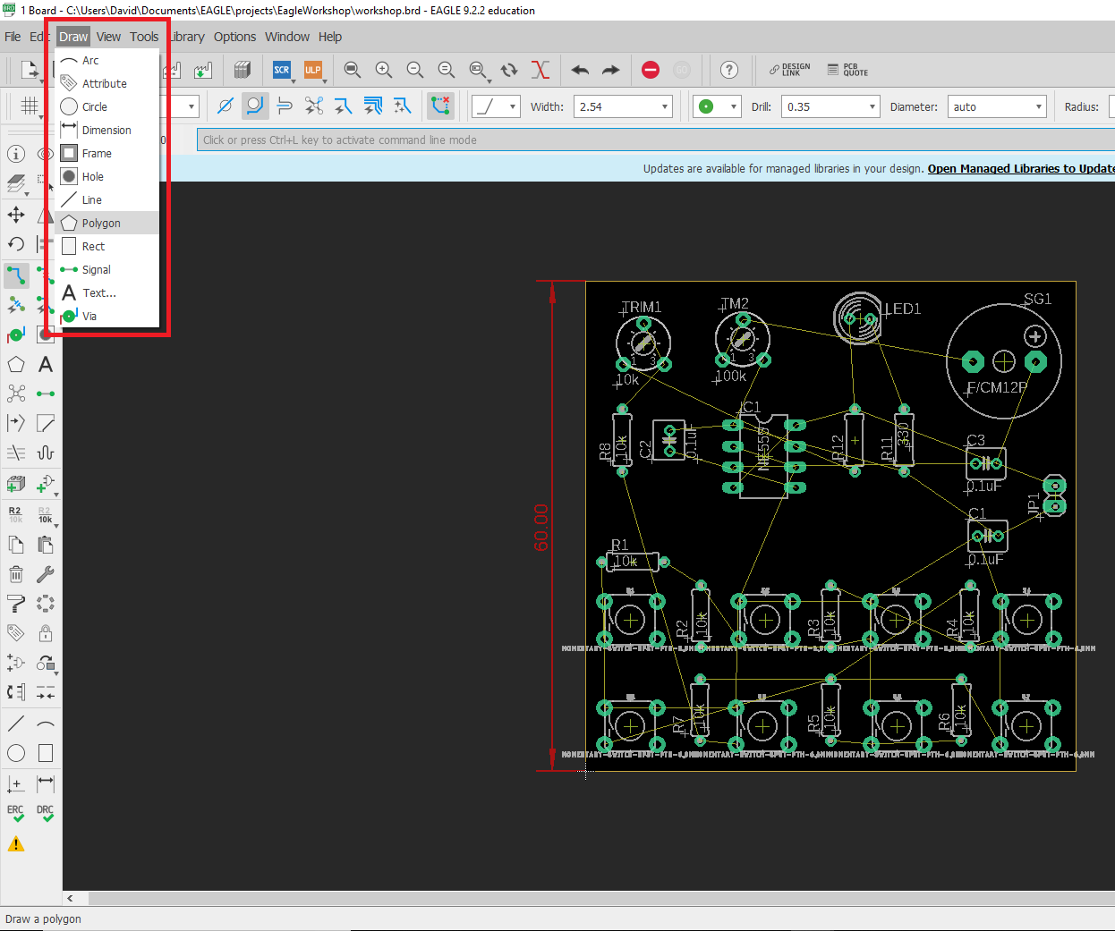
Polygon
Polygons can be used to make planes: large copper sections that can have ground, power, or other signals that have a lot of connections on your board
This lets you simply use a via or connection to connect to that plane.
Polygon lets you trace any type of shape and define what it’s signal it will carry.
Select it from the draw drop down or from the toolbar

Slide 32
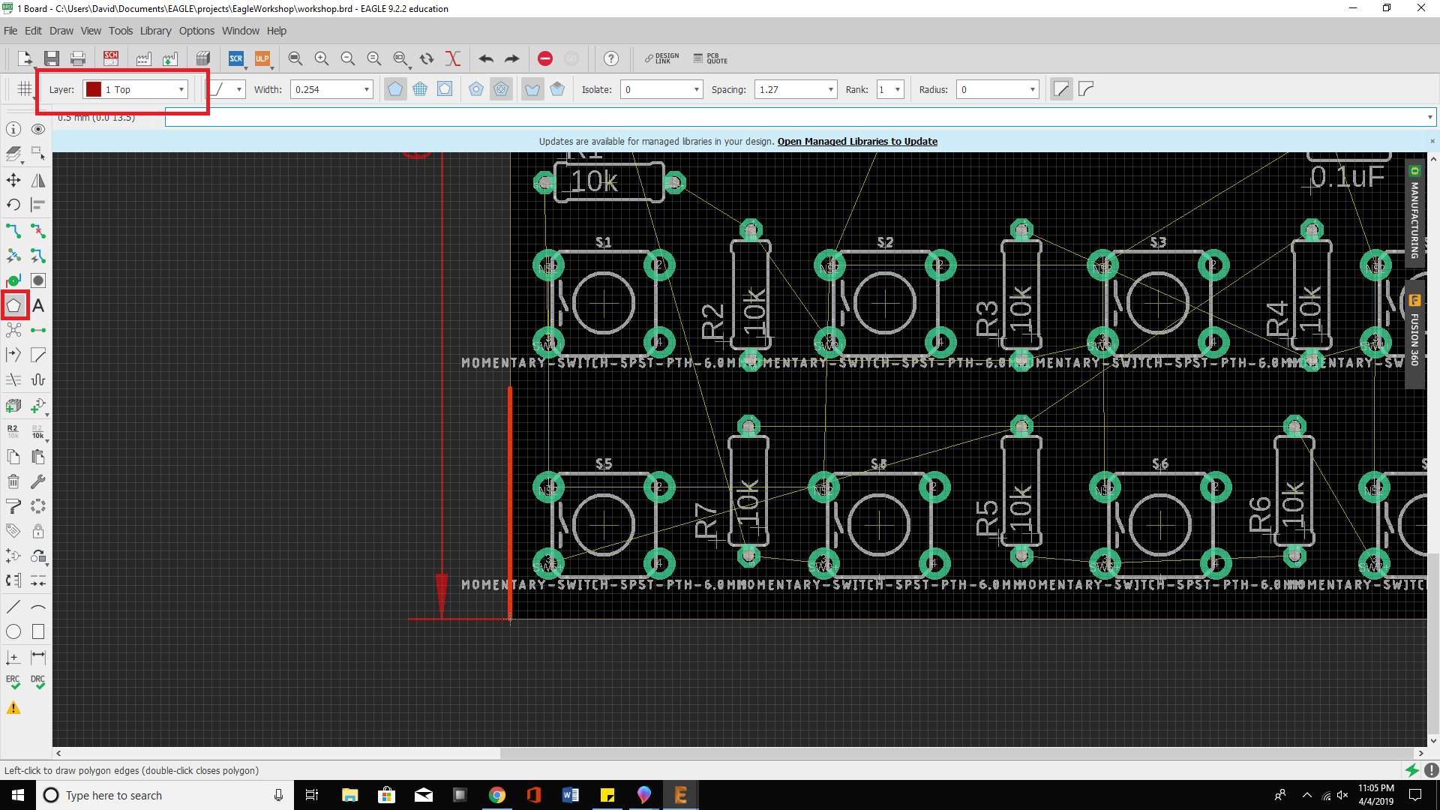
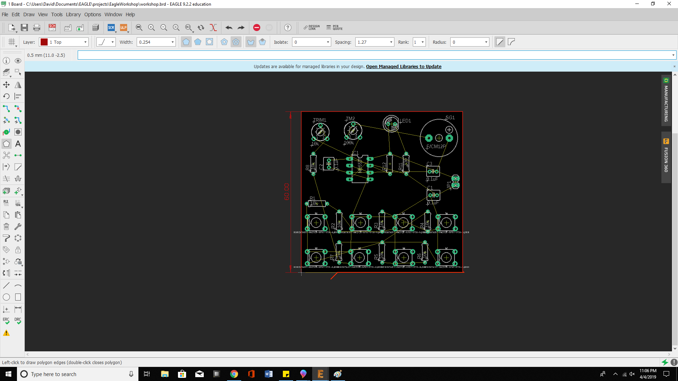
Polygon: ground plane
In this case, we will use the polygon to make a ground plane
With the top layer selected, press the polygon tool. Trace the outline of the board. At every junction (when you need to turn) press the left mouse button to set the polygon’s points.
Once you reach the end of your polygon, make sure to press the original point to fully connect. Like when you are routing, the polygon line should go from bright to dull to indicate it is connected.
In the next section we will connect the polygon to the ground signal.

Slide 33
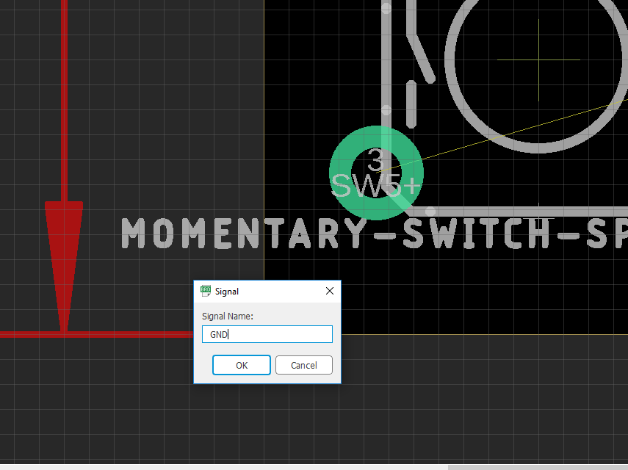
Polygon: ground plane
Once you connect the polygon, this signal box will show up
Type the name (the identifier) of the signal you want to connect to the polygon, in this case it would be ‘GND’
After you type this and press ok, press the rat’s nest botton on the toolbar, you should see the plane appear on the board.

Slide 34
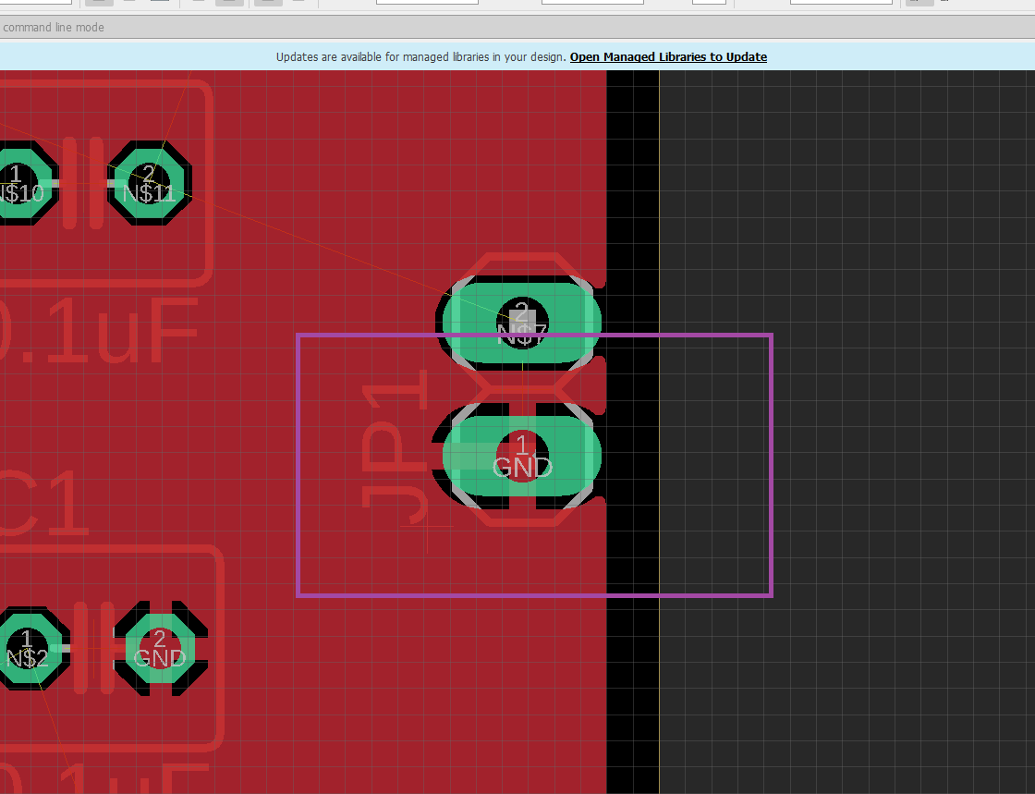
Polygon: ground plane
Find a ground connection after you make the polygon and assign it to ‘GND’
You should see that all the ‘GND’ signals are now connected to the ground plane.
Typically, you want to route the other signals on the board first, then create the planes, then check that all the plane signals are routed.

Slide 35
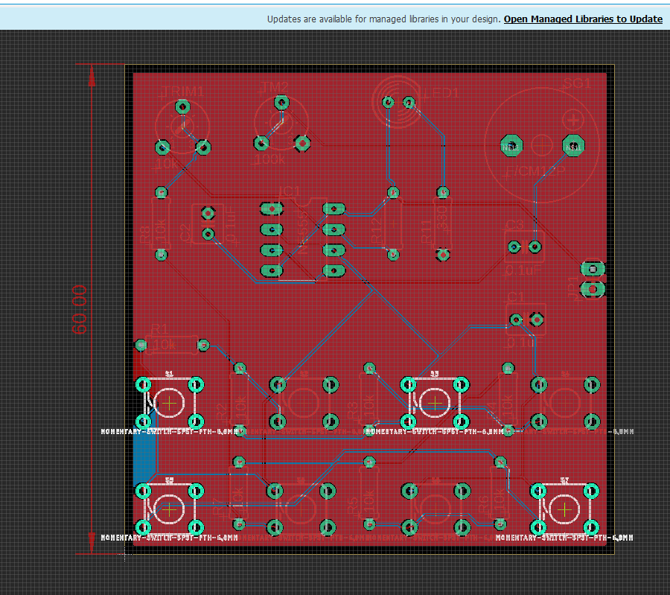
Go ahead and finish routing
Make sure you have all rat’s nest wires gone and that all pads / pins are properly connected
Make sure vias don’t overlap on unwanted trace
Make sure you have fun! Routing is part engineering part art. Try to make your traces without a lot of jitter or sharp turns.

Slide 36
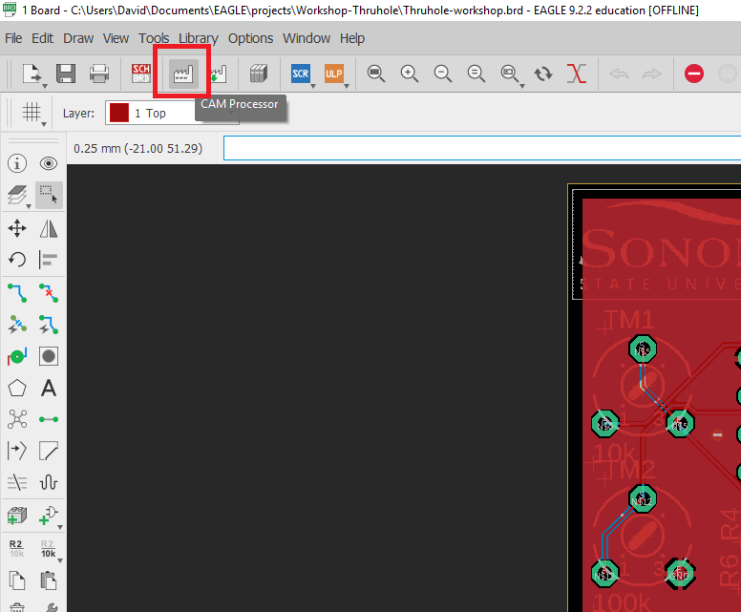
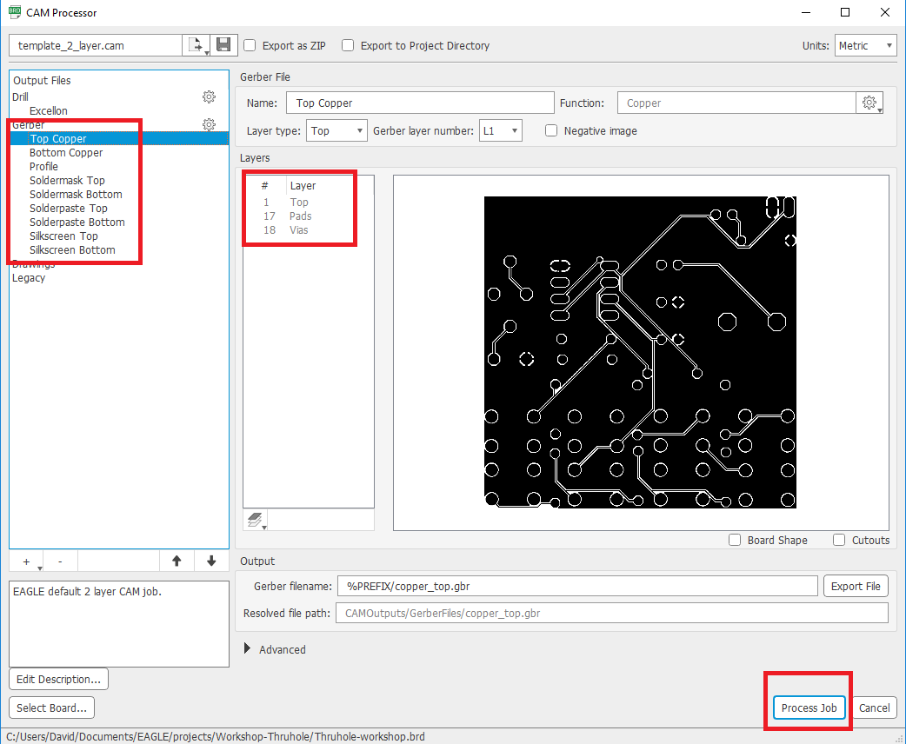
Creating Gerber Files
Press the CAM Processor button to enter the Gerber File Generation mode.
A Gerber file is how board companies machines can read and create your board. The gerbers contain the outlines and dimensions for all the layers of your board.
When in cam process, press each Gerber layer (e.g. Top Copper) and verify that there are layers selected that you want.
When you are ready, press process job to create the gerber files. You will need to specify a folder you want to save to.
When you create the gerbers, make sure to zip the folder that contains the gerber files

Slide 37
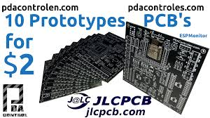
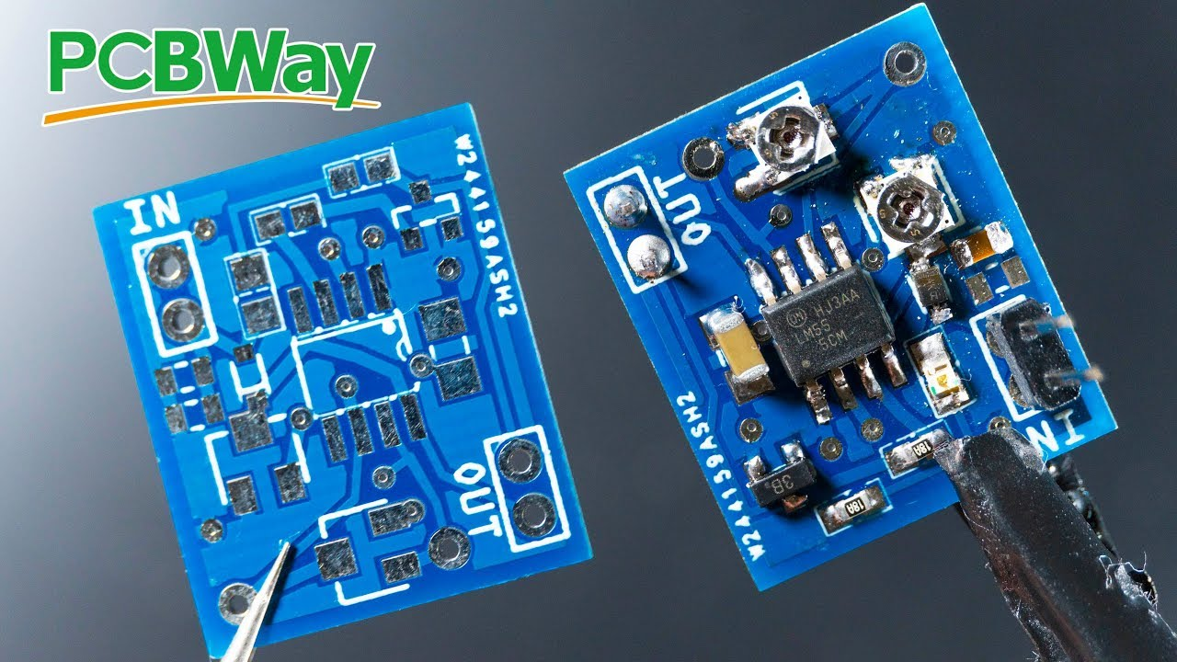

Board Houses: Fabing your PCB
A large variety of different board houses, each will have different tooling, costs, shipping, and production volume constraints
You can find the design rules on most board house websites (these design rules tell you how small you can make traces, make widths of parts, etc)
In our case, we will be using JLCPCB, since they allow you to purchase 5 boards for $2 if they are under 100 x 100 mm. This is one of the cheapest but still good quality board houses.
Other good low production run board houses include OshPark, PCBWay, and others. Their proto costs are slightly higher than JLCPCB

Slide 38
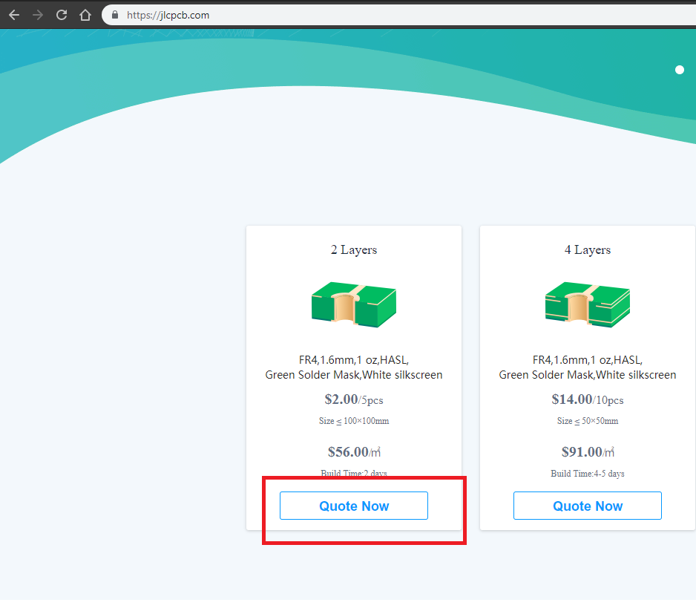
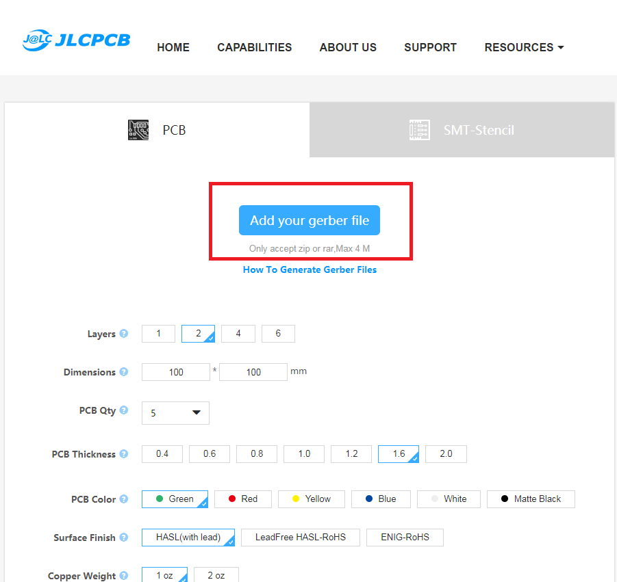
Board house: JLC PCB
We will now go to www.jlcpcb.com to upload and order our board
Press the ‘quote now’ button under ‘2 layers’, this shows that we want to create a board that is two layers (we designed for this originally)
Do not change any of the settings under the PCB tab, the settings will default the PCB layer, dimensions, quantity, color, finish, etc. to the cheapest value.
Add your zipped file by dragging it to the button that says ‘Add your gerber file’ or press the button and navigate to where your gerber folder is.
Design Rules for JLC can be found here: https://jlcpcb.com/capabilities/Capabilities

Slide 39
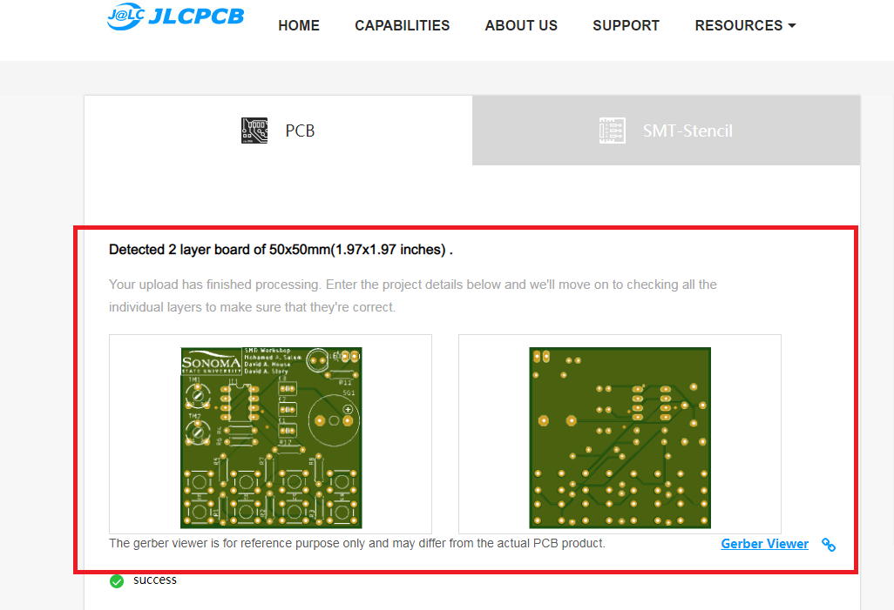
Generate & Purchase
Once you upload the files, they will be processed by JLC
Once the processing is done, you will see a rendering of what your board will look like.
This is the last time you will see the board before you receive it, so make sure to look over your schematic, board file, and the board house rendering to make sure that your design is as you see fit.
When you are ready, order the board. You will now receive your newly designed PCB! Congratulations!

